Slide 1
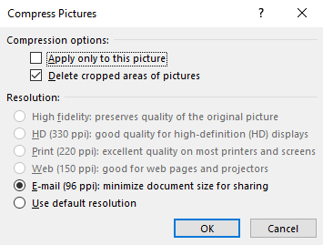
Instructions
Crop the gel picture to remove areas outside the lanes
Replace the picture in the slide (right click – replace)
Adjust the numbers so they line up with the wells:
Put first and last numbers in correct position
Left click drag to select all numbers
Arrange > Align middle, Distribute horizontally
Move all numbers to correct height
Compress pictures if file size is very large:
Select a picture
Picture format (ribbon) > Compress Pictures > Use these settings
Select picture and well numbers with Ctrl-A, then right click and save as picture
Import picture into Excel template on ‘gel’ tab

Slide 2
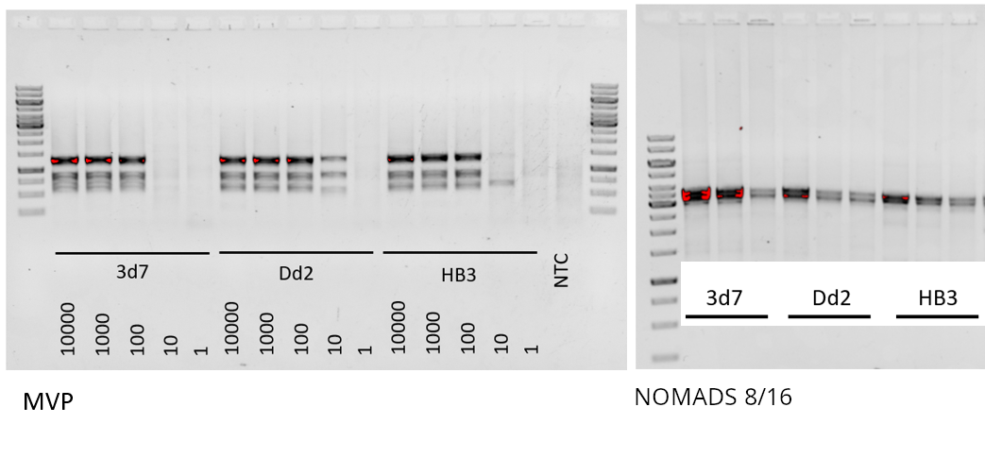
1
2
3
4
5
6
7
8
9
10
11
12
13
14
15
16
17
18
19
20
21
22
23
24
25
26
27
28

